Slide 1
SS ZG 526: Distributed Computing
Second Semester 2014-2015
Lect 14: Remaining part of Deadlocks, and P2P
Chittaranjan Hota, PhD
Dept. of Computer Sc. & Information Systems
hota@hyderabad.bits-pilani.ac.in

Slide 2
Distributed deadlock handling models
–Centralized control
–Distributed Control
–Hierarchical Control
SS ZG526, Distributed Computing

Slide 3
Cycle Vs Knot
The AND model of requests requires all resources currently being requested to be granted to un-block a computation
– A cycle is sufficient condition to declare a deadlock with
this model
The OR model of requests allows a computation making multiple different resource requests to un-block as soon as any one is granted
– A cycle is a necessary condition
– A knot is a sufficient condition
A strongly connected subgraph of a directed graph, such that starting from any node in the subset it is impossible to leave the knot by following the edges of the graph.
SS ZG526, Distributed Computing

Slide 4
Example
P2
P1
P3
P4
P7
P6
P5

Slide 5
C-M-H edge-chasing algo for AND model
Sending the probe:
if Pi is locally dependent on itself then deadlock.
else for all Pj and Pk such that
(a) Pi is locally dependent upon Pj, and
(b) Pj is waiting on Pk, and
(c ) Pj and Pk are on different sites, send probe(i,j,k) to the home
site of Pk.
Receiving the probe:
if (d) Pk is blocked, and
(e) dependentk(i) is false, and
(f) Pk has not replied to all requests of Pj,
then begin
dependentk(i) := true;
if k = i then Pi is deadlocked
else ...
for all Pm and Pn such that
(a’) Pk is locally dependent upon Pm, and
(b’) Pm is waiting on Pn, and
(c’) Pm and Pn are on different sites, send probe(i,m,n)
to the home site of Pn.
end.
SS ZG526, Distributed Computing

Slide 6
Advantages
Popular, Variants of this are used in locking schemes.
Easy to implement, as each message is of fixed length and requires few computational steps.
No graph constructing and information collection
False deadlocks are not detected
Does not require a particular structure among processes
SS ZG526, Distributed Computing

Slide 7
Disadvantages
Two or more processes may independently detect the same deadlock and hence while resolving, several processes will be aborted.
Even though a process detects a deadlock, it does not know the full cycle
M(n-1)/2 messages, where M= no. of processes, n= no. of sites.
SS ZG526, Distributed Computing

Slide 8
C-M-H diffusion computation algo for OR model
Initiation by a blocked process Pi:
send query(i,i,j) to all processes Pj in the dependent set DSi of Pi;
num(i) := |DSi|; waiti(i) := true;
Blocked process Pk receiving query(i,j,k):
if this is engaging query for process Pk /* first query from Pi */
then send query(i,k,m) to all Pm in DSk;
numk(i) := |DSk|; waitk(i) := true;
else if waitk(i) then send a reply(i,k,j) to Pj.
Process Pk receiving reply(i,j,k)
if waitk(i) then
numk(i) := numk(i) - 1;
if numk(i) = 0 then
if i = k then declare a deadlock.
else send reply(i, k, m) to Pm, which sent the engaging query.
SS ZG526, Distributed Computing

Slide 9
Deadlock persistence and resolution
Deadlock persistence:
  Average time a deadlock exists before it is resolved.
Deadlock resolution:
  Aborting at least one process/request involved in the deadlock.
  Efficient resolution of deadlock requires knowledge of all processes and resources.
  If every process detects a deadlock and tries to resolve it independently -> highly inefficient ! Several processes might be aborted.
SS ZG526, Distributed Computing

Slide 10
Peer-to-Peer (P2P) Computing and Overlay Graphs
Chapter:18
SS ZG526, Distributed Computing

Slide 11
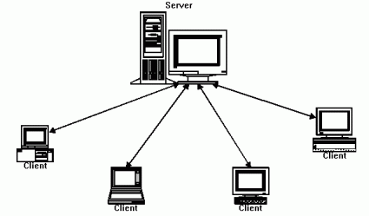
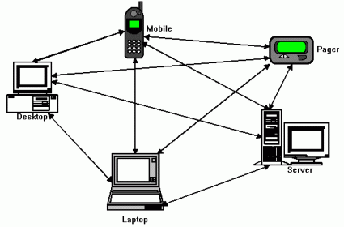
Client-server to P2P
The Client/Server Model
The Peer-to-Peer Model
SS ZG526, Distributed Computing

Slide 12
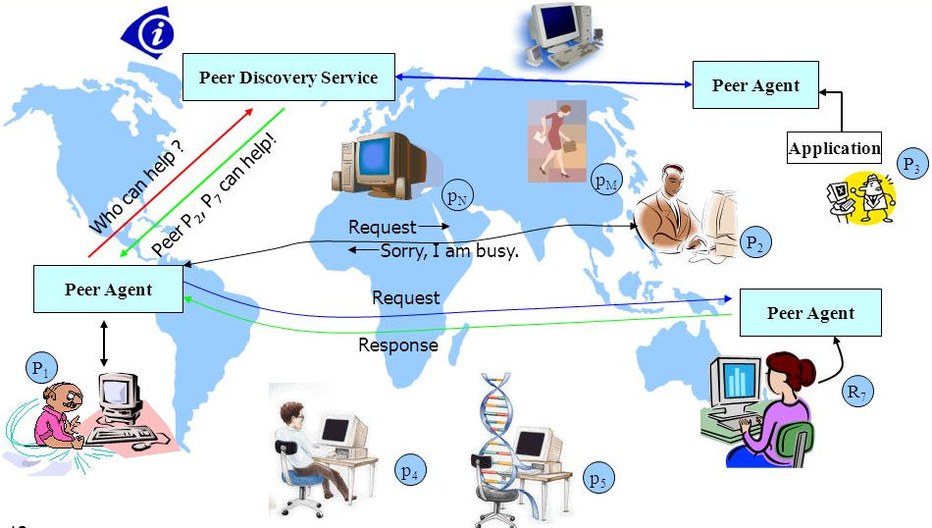
A typical P2P Computing environment
Image source: GRIDS lab, UoM
SS ZG526, Distributed Computing

Slide 13
What is a P2P Overlay?
Selfish objective
C
E
F
P2P overlay layer
A
H
D
G
B
A
C
E
F
H
AS₁
AS₄
B
AS₆
AS₂
D
Native IP layer
AS₅
Improved services
AS₃
G
SS ZG526, Distributed Computing

